Slide 1
SAP BTP Extension Suite Training
Day 20
Anubhav Oberoy
www.AnubhavTrainings.com
Follow excellence with sheer passion

Slide 2


DISCLAIMER
The training content and delivery of this presentation is confidential, and cannot be recorded, or copied and distributed to any third party, without the written consent of Anubhav Trainings

Slide 3
Agenda – Day 20
01
Scenario 1: UI Extension
02
S4 Cloud SDK
03
Scenario 2: CAP extension

Slide 4
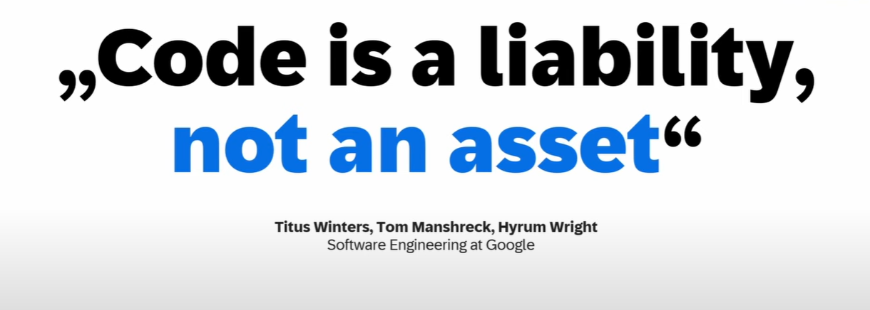

Slide 5

Looming threats

Slide 6

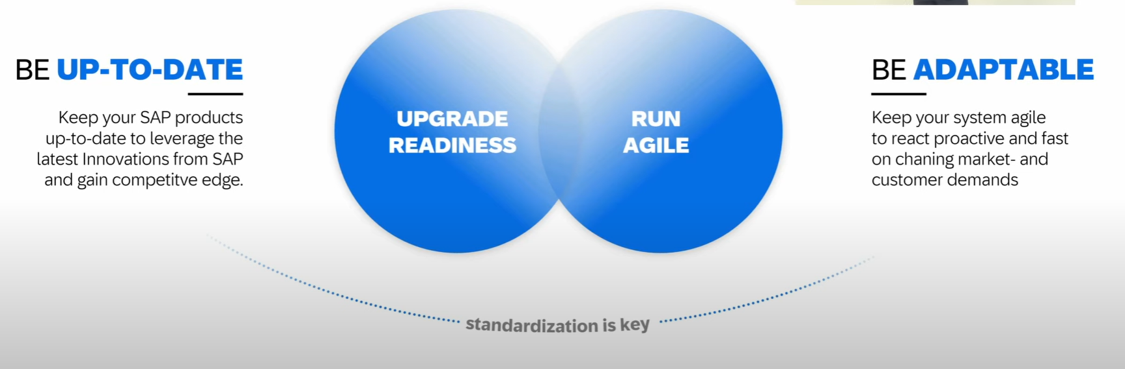
How to be Fast
11
www.anubhavtrainings.com

Slide 7
Clean Core
Clean means up-to-date, documented, unmodified, consistent, efficient and upgrade ready.
S/4HANA cloud Private Edition (On-premise) ➔ GUI Access, Full control on your system including SPRO, BADIs and custom development, postpone upgrades, Full access to code and chances of even modify standard SAP code.
85-90%
S/4HANA Cloud Public Edition ➔ Shared Environment, Standardized ERP solution one for all customers, customers cannot postpone upgrades, they cannot have SAPGUI or full access to system, Fiori only approach for accessing business applications, Force upgrade (always clean) – 10~15%
Hybrid – both.
Rise with SAP – for large corporations SAP offering a conversion to S/4HANA + BTP + SAC + DS…

Slide 8
Benefits
Access to innovation – Since your SAP S/4HANA system is not contaminated with custom code, the moment SAP comes with new Release, they can be applied immediately
Upgrade Simplicity – We can upgrade stress free.
Lower TCO – Since we follow clean core, we actually are safe from changes which upgrade brings, so SAP parters can offer an upgrade at fix cost.
Enhanced Security – you don’t need to on-board every dev in system, because they can use BTP for dev.
Improved performance – Core is clean, it does not have to interact with lots of custom code, Store your custom code in git with BTP.
Data Simplification – Which data is private, which is public.

Slide 9
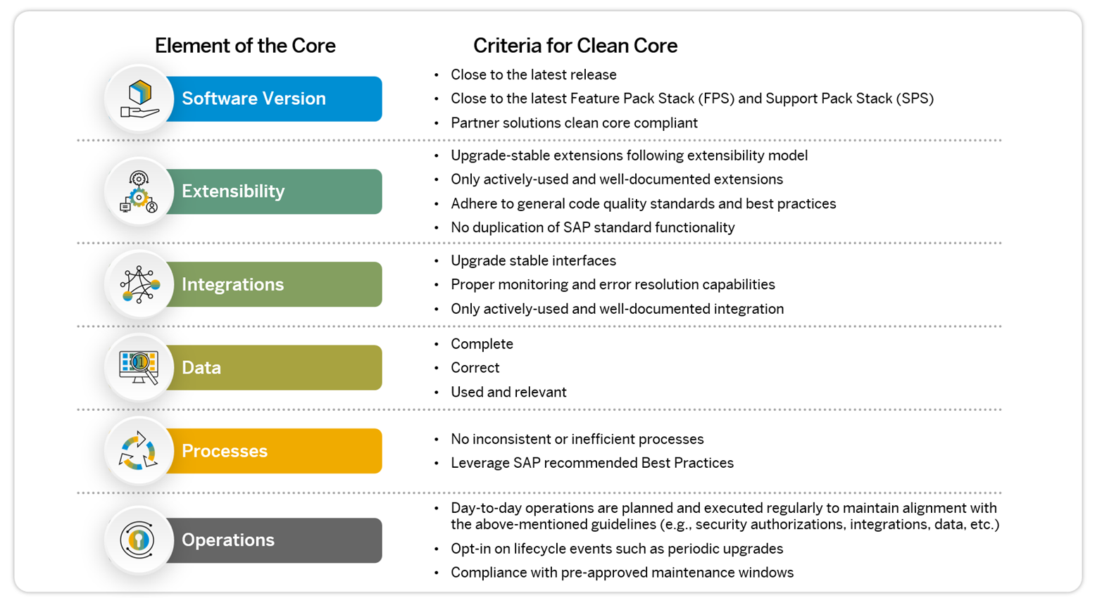
Elements of Clean Core
11
www.anubhavtrainings.com

Slide 10
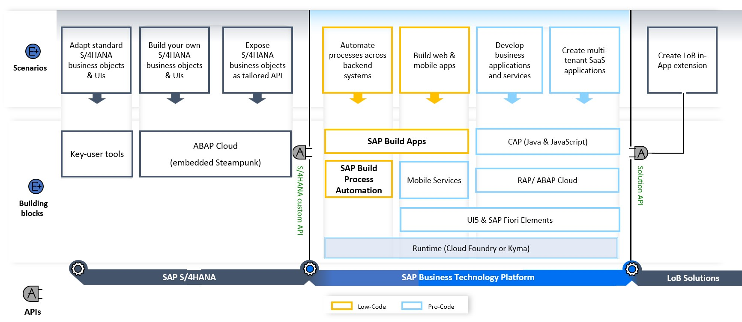
High Level Guidance
<content>
https://youtu.be/n0oS1eiOWU0
11
www.anubhavtrainings.com

Slide 11
What is API
API stands for Application Programming Interface, it is a contract to right to consume data from an external system.
11
www.anubhavtrainings.com

Slide 12




























SAP Cloud Connector

Slide 13
Anubhav Training’s S/4HANA system access
Server access details
https://youtu.be/6jk9G4vaFjQ?list=PLcxqFaocb9WLkTwNy7VsPOdEMJpLSfkcX
11
www.anubhavtrainings.com

Slide 14
APIHUB
Anubhav, where can I find all the standard SAP APIs for achieving clean core?
How can I consume standard Sales order data from my company system in BTP
I don’t want to create tables in cloud, I want reuse what I have in my company
APIHUB also known as SAP business accelerator HUB, publicly available website offered by SAP to explore all the APIs, CDS views, standard content for all SAP products under one place. So customers & partners can utilize the documentation and build side by side extensions in BTP using clean-core approach with the help of frameworks like CAP and RAP.
https://api.sap.com
11
www.anubhavtrainings.com

Slide 15
Hands on: Create Display like App for Sales Order
Enabling an OData API on SAP S/4HANA
Setting up SAP Cloud Connector and S/4HANA for principal propagation
Setting up an SAP BTP BAS Subscription
Developing of a simple Fiori Application with the SAP Business Application Studio
Deploying the application to the HTLM5 repository service
Integrating he application into the Launchpad service
Destination service – to read the destination from SAP BTP at runtime for the purpose of connection
Connectivity service – once the destination is read, it will use connectivity service to connect to our oData source
HTML5 deployer – this will be used to deploy our app to HTML5 repository.
HTML5 Repo Runtime – Will load the Fiori app when requested at runtime.
Fiori launchpad service – which displays Fiori apps as a tile.

Slide 16
Scenario 2:
Own Fiori App
SAP or Non SAP API OData which we want to reuse
Android App
SAP UI5 App
CAPM App
Middleware
Data manipulation, enrichment, Security, automation, movement, proxy
HANA

Slide 17

































Slide 18
Hands on: Initialize CAPM Extension
Create a new cap project with cds init
Drag drop edmx file downloaded from API hub and perform cds import PATH_OF_EDMX
Add a new CatalogService.cds and CatalogService.js
S4HANA cloud sdk is SAP’s portfolio of all the type safe API (node modules) to communicate to SAP APIs.
Install the node module @sap/cloud-sdk-vdm-sales-order-service
Add the configuration to test our api locally – credentials

Slide 19
Hands on: Initialize CAPM Extension
Create a new folder and initialize cap project using cds init
Go inside project and install following modules
2.1 Cloud Foundry Security - @sap/xssec, @sap/xsenv, passport
2.2 OData V2 @sap/cds-odata-v2-adapter-proxy
2.3 Serving odata v2 over cloud sdk - @sap-cloud-sdk/odata-v2
2.4 To generate the service code in node js, install cloud sdk generator module using @sap-cloud-sdk/generator
3. Create a new folder service-spec, and cds watch, after that drag drop the edmx file of our service to the folder. It will create external folder
4. Generate the JS code to automatically get all the calls which will call the service
npx generate-odata-client --input ./service-spec --outputDir ./srv/sales-order-api
Give the folder path, not the edmx file path
5. Define the service definition in CatalogService.cds file by referencing from csn file generated based on SAP OData
6. Define the service implementation CatalogService.js file and write the code to use the generated type script modules which will act like bridge to communicate to our SAP OData Business API.
7. Generate a Fiori application using free style with local cap project.

Slide 20
Hands on Cloud Extension
8. Replace hardcoded credentials with destination
9. Create a destination service and maintain destination with name S4HANA because the same we used in our code.
10. Create mta.yaml file for deployment
11. Add the modules, both srv and ui module.
12. Add Resources as destination and xsuaa. Maintain the xs-security.json file
13. Get the package json in app folder from ui project, Add the app router module @sap/approuter and include start script.
14. xs-app.json file for routing paths
15. Push the code to the github
16. You can pull the app in BAS tool, Right click on mta.yaml and build MTA Archieve
17. Once done, right click and deploy MTA_Archieve to SAP BTP

Slide 21

What We Did
Let’s Summarize

Slide 22

www.anubhavtrainings.com
Thank You
End of Day 20

Slide 23


We’re committed to empower you to be
#FutureReady
through powerful training solutions.
We build the workforce of the future.
260+
Corporate Clients
60,000+
Learners Trained
26000+
Learners Placed
FREE WEBINARS
Sign up for free webinars with industry experts every fortnight!
Enroll Now!
Contact us today!
https://anubhavtrainings.com

